Slide 1
Fuzzy fidelity in Confucian society: The case of Taiwan
  David Voas
  Department of Social Science
  University College London

Slide 2
The respondent perspective
What do our respondents care about?
What matters to them?
What affects the way they think and act, even if they’re unaware of the influence?
Is religion mostly about identity, or practice, or belief?

Slide 3
But surveys are also about us …
What do we care about?
When we do surveys, it’s our party.
We can decide what matters to us – though of course a priority might be to discover what matters to the respondents.

Slide 4
How significant is religion?
How much does anyone care?
How important is religion in life?
Answering questions about religious identity, practice and belief doesn’t necessarily mean that you know or care much about them.
Measuring religion may be less important than measuring how much it matters.

Slide 5
Substantive versus functional definitions of religion
Religion must refer to gods or spirits or fate or moral order or some such metaphysical forces, otherwise anything could potentially be religious.
But religious identity and ritual and values don’t necessarily require supernatural belief.
Hence a paradox: the expressions of religion that make the most difference, both personally and socially, can be divorced from the defining characteristic of religion.

Slide 6
Fuzzy fidelity
Religiosity isn’t black or white: it’s a continuum (or even a multi-dimensional space).
We want to know where people are located, but also which way the wind is blowing.
Religious identity can also be fuzzy (or liminal), particularly in East Asia. See the graph for Taiwan by Hsing-Kuang Chao …

Slide 7
A Survey Study of Commonality and Uniqueness of Religiosity among Traditional Chinese Religions in Contemporary Taiwan
Hsing-Kuang Chao
Tunghai University, Taiwan
Oct. 11~12, 2017

Slide 8
Three Major Taiwanese Religions
(separately and in total) 1985~2016 source: Taiwan Social Change Survey (TSCS)

Slide 9
Chinese religion
Note that ‘popular’ (or ‘folk’) religion and Buddhism seem to show mirror image fluctuations.
As a result, ‘traditional religion’ in total (the sum of folk religion, Buddhism and Taoism) is less noisy than the separate components.
Perhaps we should think of Chinese religion as being more or less unitary, rather than trying to force it into the Western model?

Slide 10
But not everything is different
Just as in the West, there is a generational rise in the number of religious nones.
The ‘no religion’ share more than doubles from people born in 1970s to the 1990s (8 to 19%).
And see the following charts on belief, where the generational gradient is striking.

Slide 11
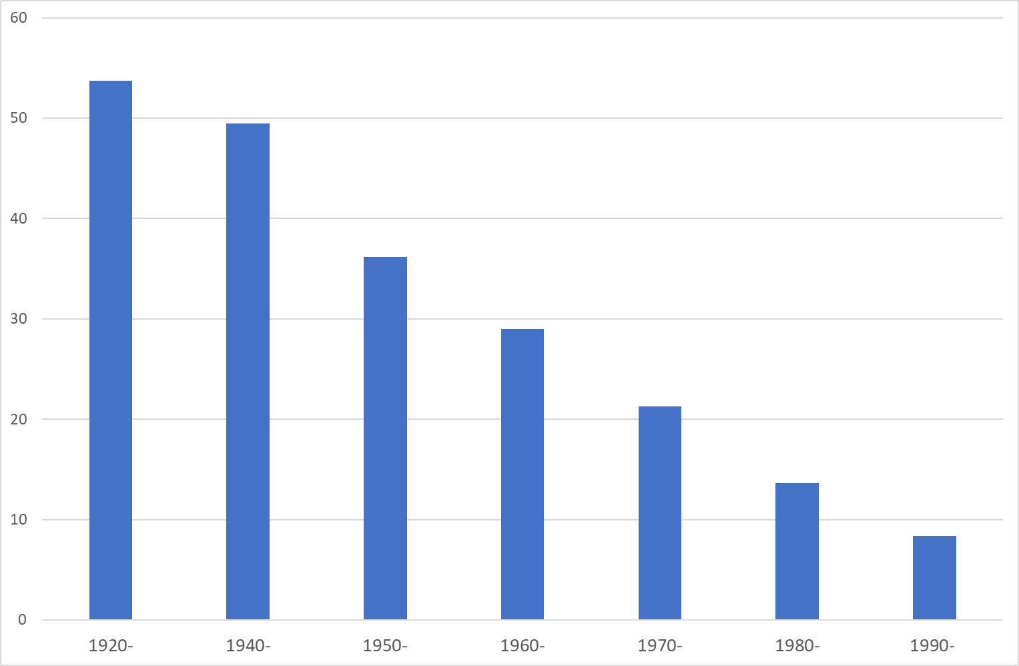
Knows God exists and has no doubts (%), by decade of birth
(Taiwan Social Change Survey 2014)

Slide 12
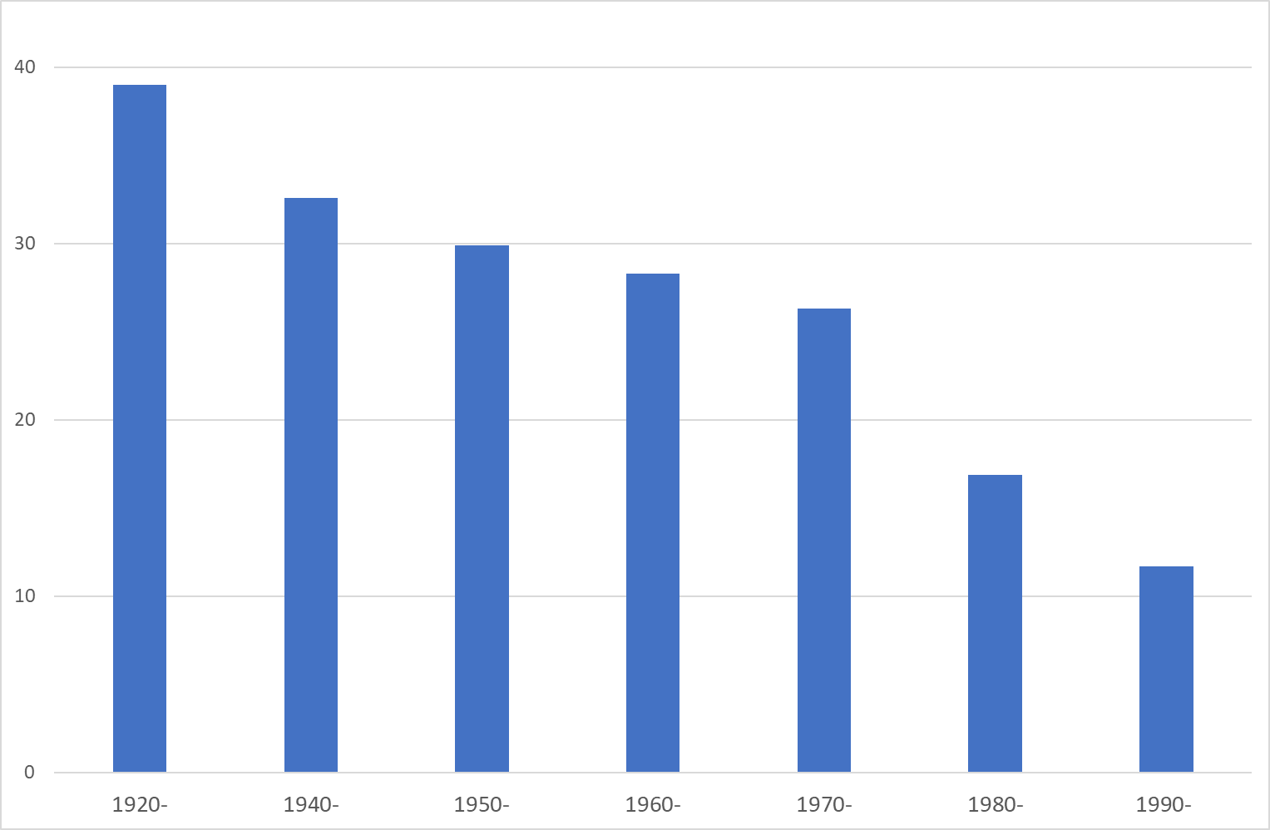
Describes self as extremely or very religious (%), by decade of birth
(Taiwan Social Change Survey 2014)

Slide 13
Belief and practice in Chinese religion
Chinese religion seems very instrumental to Western eyes: temple visitors seek success and progeny.
But adherents are pragmatic; religious practice looks like hedging rather than total investment.
82% agreed that “if you work hard, you do not necessarily have to rely on the gods”.
The focus is on proper practice rather than right belief (unlike the prosperity gospel).

Slide 14
Problems in measuring practice
Pluralism (as Anna Sun suggests, a better term than syncretism)
Private or occasional rather than congregational and regular
Fuzzy boundary between the secular and sacred
Is reverence religious?

Slide 15
The secular as sacred
Confucius recognised the importance of ritual practice many centuries before Durkheim – and moreover his ideas have been far more influential in East Asia than Durkheim’s have been in the West.
Recommended reading:
Herbert Fingarette (1972)
Confucius: The Secular as Sacred

Slide 16
Religious or cultural practice?
Rites of passage were traditionally the domain of religion.
Religion is good at solemnity, and tradition has a value that transcends the belief system on which it is based.
But the parties involved may not be religious ...
And in any case the boundary between the sacred and secular is fuzzy.

Slide 17
Ancestor veneration
Why do we visit our grandparents’ graves?
Often a ritual of respect, but not necessarily religious.
A prayer at the graveside might make it religious, even if it’s purely a ritual (practice without belief).
What about voicing a thought for the deceased? Non-religious, or perhaps privatised spirituality?
What if I leave something on the grave? Pure ritual or magical thinking?

Slide 18
What counts as religion?
The point is that there is no bright boundary between the religious and the non-religious.
East Asian religion in particular lends itself to a blurring of the distinction between the secular and the sacred.
Classifications are inevitably fuzzy.
We shouldn’t be dissuaded from measuring – but the output may be better suited to looking at trends rather than levels.

