Slide 1
The State of Race in America
Aspen Institute Symposium
April 22, 2013

Slide 2
Demographics
Politics
Education
Economics
Group Relations
Intermarriage
Identity

Slide 3
The Changing Face of America,1950-2050
Percent of Total Population
Source: Pew Research Center Population Projections.

Slide 4
2012 Presidential Vote by Race/Ethnicity
%
Source: Pew Research Center analysis of the national exit poll data, 1980-2012

Slide 5
Presidential Vote For the Democratic Candidate, 1980-2012
%
Source: Pew Research Center analysis of the national exit poll data, 1980-2012
Notes:
Source: Pew Hispanic Center analysis of the national exit poll data, 1980-2012

Slide 6
Voter Turnout Rates in Presidential Elections,1988-2008
%
Source: Pew Research Center tabulations of the CPS (Nov supplements).
Notes:
Source: Pew Hispanic Center tabulations of the CPS (Nov supplements).

Slide 7
College Graduates by Race and Ethnicity
% with a college degree (among adults ages 25+)
Source: Pew Research Center analysis of March 2012 Current Population Survey.
Notes:
Second gen report

Slide 8
Median Household Income, By Race/Ethnicity 2012
Source: Pew Research Center analysis of March 2012 Current Population Survey.
Notes:
March 2012 CPS

Slide 9
Median Household Wealth, 2011
In 2011 dollars
Source: Pew Research Center analysis of Survey of Income and Program Participation data

Slide 10
Views about the National Economy among Blacks and Whites, 2004-2013
Source: Pew Research Center various surveys.

Slide 11
How Well Does Your Group Get Along with Other Groups?
% saying that their group gets along well with other groups
Source: Pew Research Center 2012 National Survey of Latinos & 2012 Asian-American Survey
Notes:
Source: 2012 National Survey of Latinos & 2012 Asian-American Survey

Slide 12
Intermarriage Trend,1980-2010
% married someone of a different race/ethnicity
Source: Pew Research Center analysis of the Decennial Census and American Community Surveys, IPUMS files.
Notes:
Source: Pew Research Center analysis of the Decennial Census and American Community Surveys (ACS) Integrated Public Use Microdata Sample (IPUMS) files

Slide 13
Intermarriage Rate, by Race/Ethnicity
% of newlyweds in 2010 who married someone of a different race or ethnicity
Source: Pew Research Center analysis of 2010 American Community Survey, IPUMS files.

Slide 14
Intermarriage Types, Newly Married Couples in 2010
Source: Pew Research Center analysis of 2010 American Community Survey, IPUMS files.

Slide 15
Do You Think of Obama as Black or Mixed Race? (% saying…)
Source: Pew Research Center race survey, conducted Oct 28-Nov30,2009 (N=2,884)
Notes:
Note: Question was worded “Do you mostly think of Obama as a black person or mostly as a person of mixed race?. Source: Pew Research Center race survey, conducted Oct 28-Nov30,2009 (N=2,884)

Slide 16
Which Term Do You Use Most Often to Describe Yourself?
% saying
Source: Pew Research Center 2012 National Survey of Latinos & 2012 Asian-American Survey

Slide 17
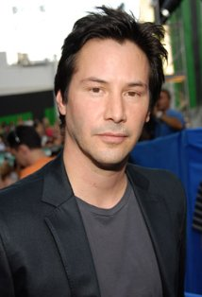
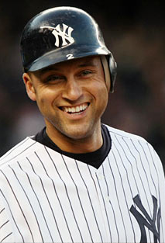
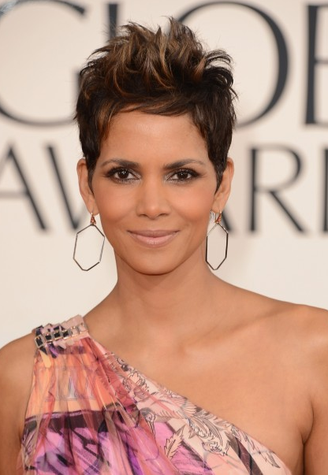
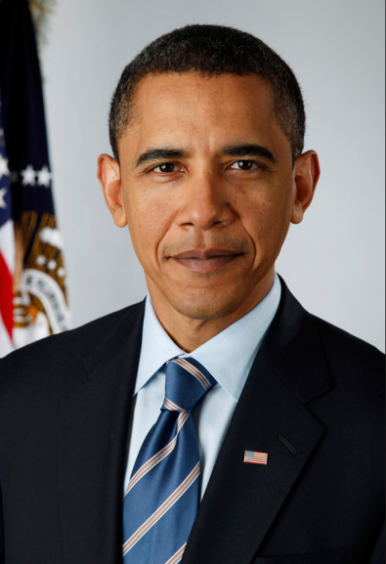
A-List Celebrities
Beyoncé
Keanu Reeves
Salma Hayek
Derek Jeter
Tiger Woods
Cameron Diaz
Halle Berry
Barack Obama

Slide 18
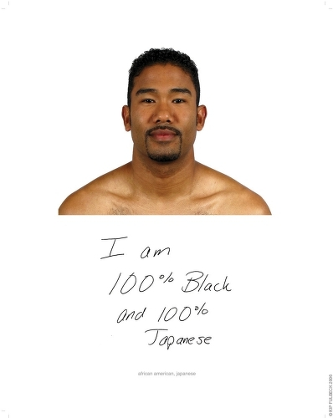
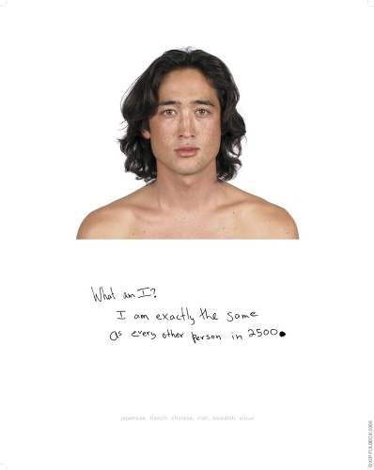
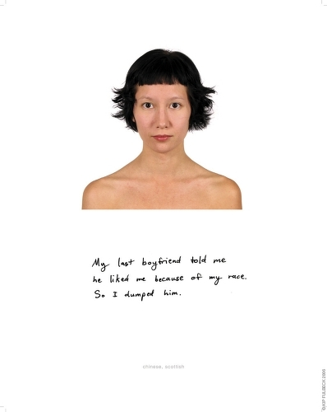
Hapa America
“I am 100% Black and 100% Japanese.”
“I am exactly the same as every other person in 2500.”
“My last boyfriend told me he liked me because of my race. So I dumped him.”
Source: Doubles, Triples and Halves: Kip Fulbeck’s Hapa Project (2002) (http://hdl.handle.net/2027/spo.7977573.0002.107)

Slide 19
1615 L Street, NW, Suite 700
Washington, DC 20036-5631
202-419-3600(main) 202-419-3608(fax)
www.pewresearch.org

