Slide 1
New data on how Americans use and engage with public libraries
Kathryn Zickuhr
Research Associate, Pew Research Center’s Internet Project
June 18, 2014
@kzickuhr | @pewinternet | @pewresearch
libraries.pewinternet.org

Slide 2
About the Pew Research Center
Non-partisan think tank in Washington, DC
Does not promote specific technologies or make policy recommendations
More: pewresearch.org
@pewresearch
@pewinternet

Slide 3
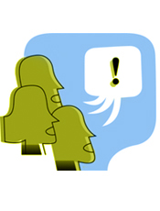
About our libraries research
Nationally representative telephone surveys
Landlines and cell phones
English and Spanish
Americans ages 16 and older
libraries.pewinternet.org
libraries.pewinternet.org / @kzickuhr / @pewinternet
Notes:
For more information, see the Methods section of each report.

Slide 4
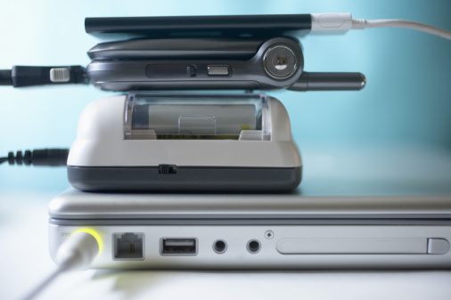
Notes:
Part 1: Patterns and trends in device ownership

Slide 5
Internet use over time
% of U.S. adults ages 18+ who go online, 1995-present
87%(2014)
14% (1995)
2014
www.pewinternet.org
Notes:
In June 1995, 14% of American adults used the internet.
By the year 2000, just five years later, half of adults were online.
Now, eight in ten adults use the internet, including half of seniors 65 and older.

Slide 6
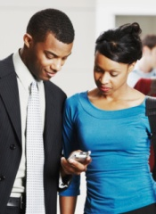
Adults’ technology ownership in the U.S. (ages 18+)
90% of adults have a cell phone
78% have a desktop or laptop computer
58% have a smartphone
42% have a tablet computer
32% have an e-reader
www.pewinternet.org
Notes:
At the time of this survey, comparable to adults

Slide 7
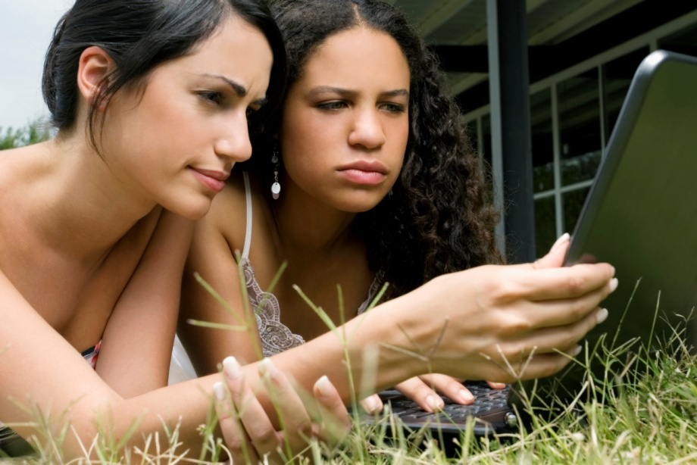
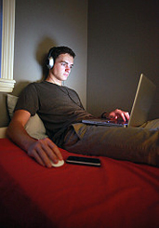
71% of teens with home computer access say the laptop or desktop they use most often is one they share with other family members.
www.pewinternet.org

Slide 8
Americans’ reading habits
Print is still the anchor of Americans’ reading habits, but e-reading is growing more popular.
76% of adults read a book in some format over the previous year.
Median: 5 books per year
28% of Americans read an e-book in the previous year.
libraries.pewinternet.org / @kzickuhr / @pewinternet

Slide 9
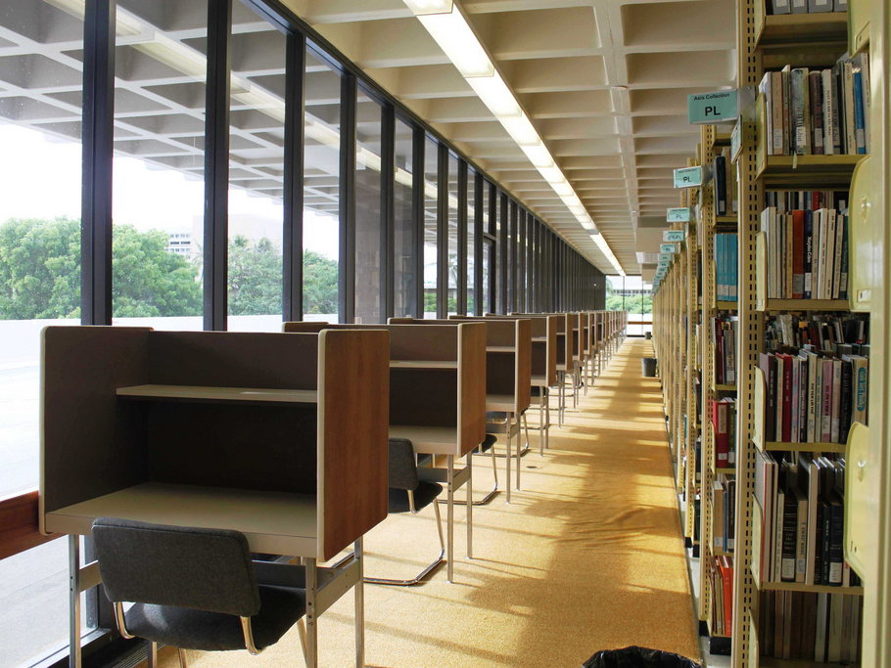

Slide 10
Americans and public libraries
54% of Americans used a public library in the past year
48% visited in person
30% used a library website
72% of Americans live in a “library household”
libraries.pewinternet.org / @kzickuhr / @pewinternet

Slide 11
Americans and public libraries
54% of Americans used a public library in the past year
48% visited in person
30% used a library website
72% of Americans live in a “library household”
91% of Americans say libraries are important to their community as a whole; 76% say libraries are important to them and their family
libraries.pewinternet.org / @kzickuhr / @pewinternet

Slide 12
Americans and public libraries
54% of Americans used a public library in the past year
48% visited in person
30% used a library website
72% of Americans live in a “library household”
91% of Americans say libraries are important to their community as a whole; 76% say libraries are important to them and their family
Relationships to libraries are part of Americans’ broader resource networks
libraries.pewinternet.org / @kzickuhr / @pewinternet

Slide 13
Public library services that are “very important”
Among Americans who have ever used a public library or had a household member use a public library
libraries.pewinternet.org / @kzickuhr / @pewinternet

Slide 14
What do Americans want from libraries?
More activities, more separate spaces
…and print books, quiet
Convenience & tech (apps, e-books, kiosks)
… and closer relationships with librarians
libraries.pewinternet.org / @kzickuhr / @pewinternet
Notes:
For more information, see “Library services in the digital age”: http://libraries.pewinternet.org/2013/01/22/library-services/

Slide 15
Summary: How Americans use libraries
Relationships to libraries are part of Americans’ broader resource networks
Once libraries are a part of their networks, services are especially important to low-income households
libraries.pewinternet.org / @kzickuhr / @pewinternet

Slide 16
Summary: How Americans use libraries
Relationships to libraries are part of Americans’ broader resource networks
Once libraries are a part of their networks, services are especially important to low-income households
Books, browsing, and librarians are still central to how people use libraries and what they expect from them.
However, technology (computers, internet) is also a common use and a high priority.
Public libraries are also used and viewed as important community spaces.
libraries.pewinternet.org / @kzickuhr / @pewinternet

Slide 17
Thank you!
Kathryn Zickuhr
Pew Research Center
Research Associate
pewresearch.org
kzickuhr@pewresearch.org
June 18, 2014
@kzickuhr | @pewinternet | @pewresearch
libraries.pewinternet.org
Notes:
All library-related reports are available at: http://libraries.pewinternet.org/category/publications/survey-reports/

