Slide 1
The internet’s turbulent next decade
Lee Rainie
Pew Research Center Internet Project
Janna Anderson
Elon University – Imagining the Internet Center
Presented to: World Future Society
July 12, 2014

Slide 2
Our inspirer

Slide 3
Our ‘news peg’

Slide 4
2004-2011 Disruptions and Disputes

Slide 5
Survey 6 – 2013-4
November 25–January 13
2,551 respondents
19% research scientist
10% authors, editors, journalists
9% entrepreneurs, biz leader
8% tech developers
8% activists
7% futurists, consultants
2% legislators, lawyers
2% pioneers
http://bit.ly/OgpZkS
Digital Life in 2025
The Internet of Things Will Thrive by 2025
Net Threats by 2025

Slide 6
Digital Life in 2025
This is an open-ended question allowing you to make your own prediction about the role of the Internet in people’s lives in 2025 and the impact it will have on social, economic and political processes. Good and/or bad, what do you expect to be the most significant overall impacts of our uses of the Internet on humanity between now and 2025?

Slide 7
Digital Life in 2025
The Internet will become ‘like electricity’ — less visible, yet more deeply embedded in people’s lives for good and ill

Slide 8
Development Themes
A global, immersive, invisible, ambient networked computing environment built through the continued proliferation of smart sensors, cameras, software, databases, and massive data centers in a world-spanning information fabric known as the Internet of Things.
“Augmented reality” enhancements to the real-world input that people perceive through the use of portable / wearable / implantable technologies.
Disruption of business models established in the 20th century (most notably impacting finance, entertainment, publishers of all sorts, and education).
Tagging, databasing, and intelligent analytical mapping of the physical and social realms.

Slide 9
Hopeful theses
1) Information sharing over the Internet will be effortlessly interwoven into daily life.
2) The spread of the Internet will enhance global connectivity that fosters more planetary relationships and less ignorance.
3) The Internet of Things, artificial intelligence, and big data will make people more aware of their world and their own behavior.
4) Augmented reality and wearable devices will be implemented to monitor and give quick feedback on daily life, especially tied to personal health.
5) Political awareness and action will be facilitated and more peaceful change and public uprisings like Arab Spring will emerge.
6) An Internet-enabled revolution in education will spread more opportunities, with less money spent on real estate and teachers.

Slide 10
Downbeat theses
1) Dangerous divides between haves and have-nots may expand, resulting in resentment and possible violence.
2) Abuses and abusers will ‘evolve and scale.’ Human nature isn’t changing; there’s laziness, bullying, stalking, stupidity, pornography, dirty tricks, crime, and those who practice them have new capacity to make life miserable for others.
3) Pressured by these changes, governments and corporations will try to assert power as they invoke security and cultural norms.
4) People will continue — sometimes grudgingly — to make tradeoffs favoring convenience over privacy; and privacy will be something only the upscale will enjoy.
5) Humans and their organizations may not respond quickly enough to challenges presented by complex networks.

Slide 11
The Internet of Things Will Thrive by 2025
The evolution of embedded devices and the Internet/Cloud of Things —As billions of devices, artifacts, and accessories are networked, will the Internet of Things have widespread and beneficial effects on the everyday lives of the public by 2025?

Slide 12
Future of Internet of Things
No
Yes – widespread and beneficial
83%
17%

Slide 13
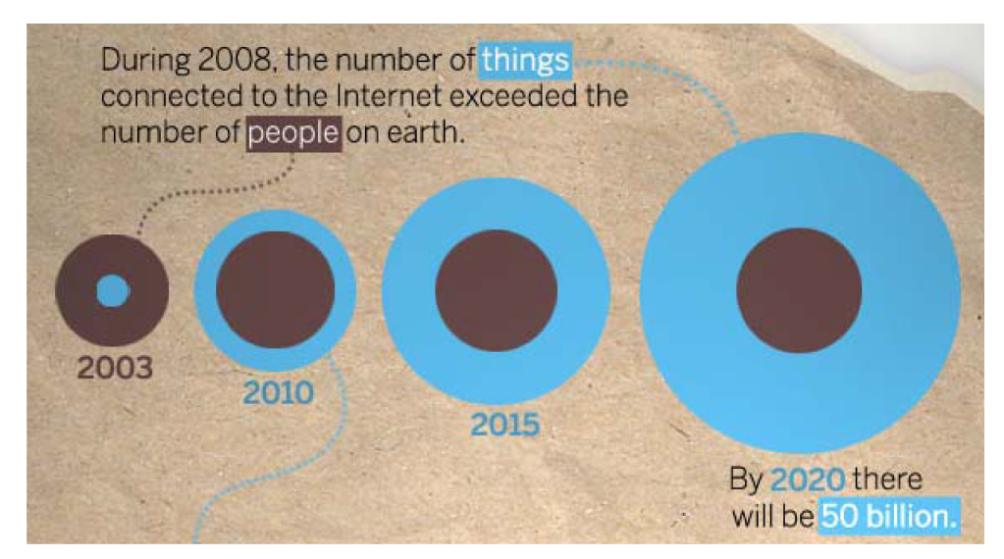
The Internet of Things Will Thrive by 2025
It‘s the next revolution. Upsides: enhanced health, convenience, productivity, safety, and vastly more useful information. Downsides: privacy challenges, over-hyped expectations, and tech complexity.

Slide 14
Development Themes

Slide 15
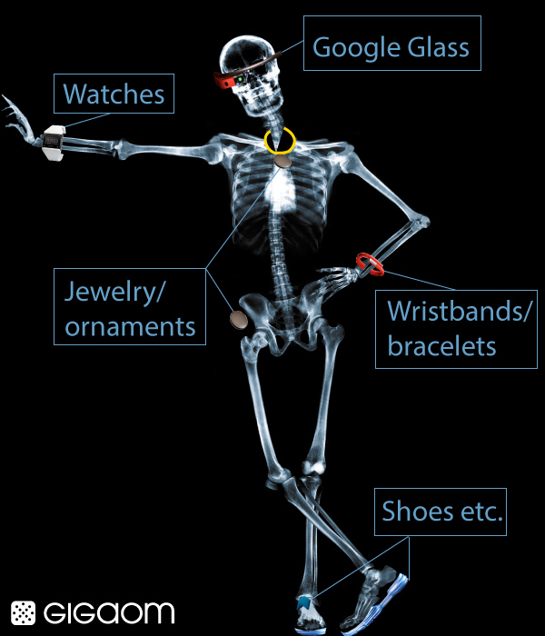
body

Slide 16
homes

Slide 17
communities

Slide 18
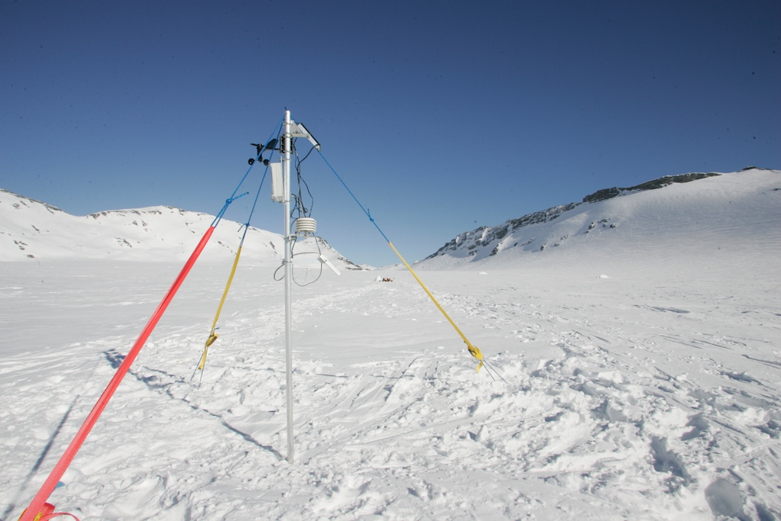
environment

Slide 19
Themes
1) The realities of this data-drenched world raise substantial concerns about privacy and people’s abilities to control their own lives. The level of profiling and targeting will grow and amplify social, economic, and political struggles.
2) Information interfaces will advance—especially voice and touch commands. But few expect that brain-to-network connectivity will be typical in most people’s daily lives by 2025
3) There will be complicated, unintended consequences: ‘We will live in a world where many things won’t work and nobody will know how to fix them.’
4) The unconnected and those who just don’t want to be connected may be disenfranchised.

Slide 20
Net Threats by 2025
Accessing and sharing content online—By 2025 will there be significant changes for the worse and hindrances to the ways in which people get and share content online compared with the way globally networked people can operate online today?

Slide 21
Future of Content Sharing
Yes – significant hindrances
No (optimistic response)
35%
65%

Slide 22
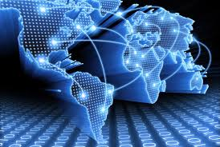
Net Threats by 2025
Experts have hope, but anticipate battles to preserve openness.

Slide 23
Threats
1) Actions by nation-states to maintain security and political control will lead to more blocking, filtering, segmentation, and balkanization of the Internet.
2) Trust will evaporate in the wake of revelations about government and corporate surveillance and likely greater surveillance in the future.
3) Commercial pressures affecting everything from Internet architecture to the flow of information will endanger the open structure of online life.
4) Efforts to fix the TMI (too much information) problem might over-compensate and actually thwart content sharing.

Slide 24
Why predictions matter
Ithiel De Sola Poole, “Technologies of Freedom”
On the printing press, telegraph, radio, television
“These technologies caused revised conceptions of man's place in the universe”

Slide 25
Amen!

