Slide 1
Dating & Mating in the Digital Age: Relationships and technology in the modern era
Council on Contemporary Families
Miami, FL
April 26, 2014
Amanda Lenhart, Senior Researcher
Pew Research Center

Slide 2
About Pew Internet / Pew Research
Part of the Pew Research Center, a non-partisan “fact tank” in Washington, DC
Studies how people use digital technologies
Does not promote specific technologies or make policy recommendations
Data for this talk is from nationally representative telephone surveys of U.S. adults
Notes:
Thanks Aaron Smith – author of Online Dating report.
Data from Couples, the Internet and Social Media: http://www.pewinternet.org/2014/02/11/couples-the-internet-and-social-media/
And
Online Dating and Relationships: http://www.pewinternet.org/2013/10/21/online-dating-relationships/

Slide 3
People have long sought assistance in finding a romantic partner
Family and religious institutions → Matchmaking and arranged marriages
Newspapers → Printed personal ads
VCR → Video personals
Internet era → Online dating sites
Personal ads (Match, OKCupid, Plenty of Fish)
Algorithmic (eHarmony)
Apps (Tinder, Grindr, Coffee meets Bagel)

Slide 4
Long-term changes in the nature of dating and relationships
Record-low 51% of the public is now married
Americans are waiting until later in life to get married
“Non-traditional” living arrangements are increasingly common
Other factors making dating challenging:
Increased mobility/migration, dispersal of social networks
Longer commutes
Demands of work life
Notes:
Sources: http://www.pewsocialtrends.org/2011/12/14/barely-half-of-u-s-adults-are-married-a-record-low/?src=sdt-carousel

Slide 5
Dating in the digital era
Online dating – adoption and shifting attitudes
Online dating – user experiences
Other aspects of digital dating and relationships

Slide 6
11% of Americans have used dating sites or apps
Among the currently “single and looking,” 38% have used online dating
High usage groups include:
Those in their mid-20s to mid-40s
College attendees
Urban and suburbanites
Main difference between dating site and dating app users: age
Median age of dating site users: 38
Median age of dating app users: 29

Slide 7
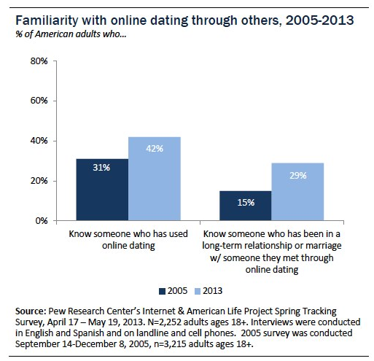
Notes:
Trends in device ownership among American adults (18+), 2006-2012

Slide 8
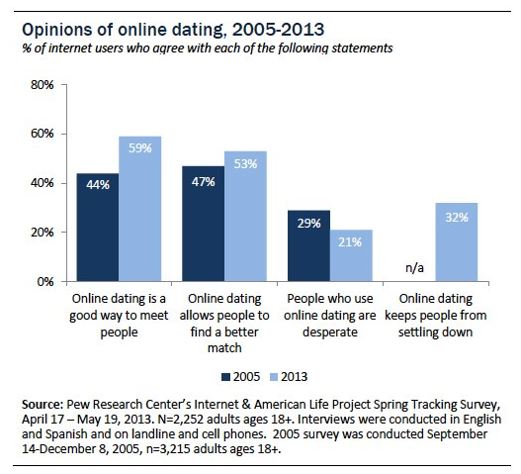
Notes:
Trends in device ownership among American adults (18+), 2006-2012

Slide 9
Dating in the digital era
Online dating – adoption and shifting attitudes
Online dating – user experiences
Other aspects of digital dating and relationships

Slide 10
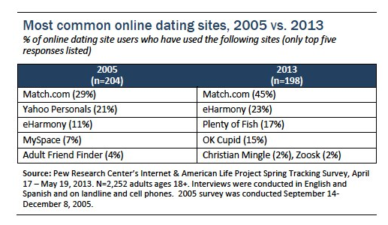
Notes:
Trends in device ownership among American adults (18+), 2006-2012

Slide 11
Experiences with online dating
Not everyone “succeeds” at online dating:
66% of online daters have actually gone on a date with someone they met on the sites
23% of online daters have entered into a marriage or long-term relationship with someone they met there
Most (but not all) online daters enjoy the process
79% agree that online dating is a good way to meet people
70% agree that it helps people find a good romantic match
At the same time, 13% agree with the statement that “people who use online dating sites are desperate”

Slide 12
Other experiences
54% of online daters say that someone else has seriously misrepresented themselves on their profile
28% have been contacted in a way that made them feel harassed or uncomfortable
40% have used a site designed for people with shared interests or backgrounds
33% have used a paid dating site/app
4% have attended a group outing or event organized by an online dating site

Slide 13
Major reasons for using online dating
60% → Meeting people who share similar interests or hobbies
52% → Meeting people who share your beliefs or values
46% → Finding someone for a long-term relationship or marriage
33% → Having a schedule that makes it hard to meet interesting people in other ways
25% → Meeting people who just want to have fun without being in a serious relationship

Slide 14
Dating in the digital era
Online dating – adoption and shifting attitudes
Online dating – user experiences
Other aspects of digital dating and relationships

Slide 15
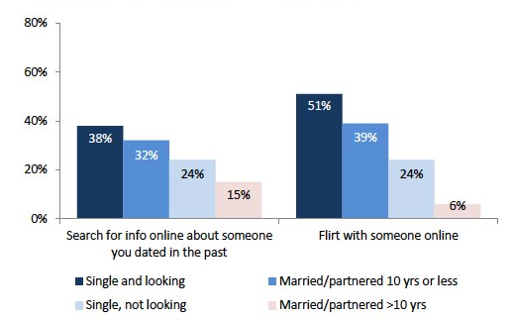
Flirting and looking up old flames
24% of internet users have searched for information online about someone they dated in the past, up from 11% in 2005
24% of internet users have flirted with someone online, up from 15% in 2005

Slide 16
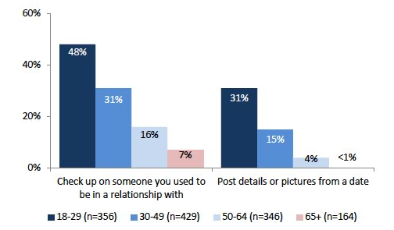
Social networks
31% of SNS users have used sites like Facebook to check up on past relationships
17% have posted pictures or details from a date

Slide 17
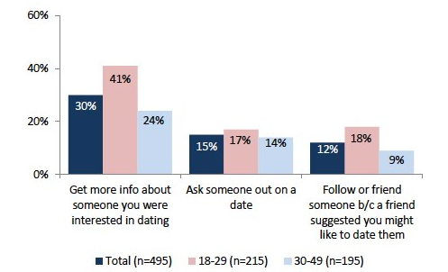
Among SNS users with recent dating experience…
30% have used sites like Facebook to get info on someone they were interested in dating
15% have used them to ask someone out on a date
12% have friended someone because another friend said they might like to date them

Slide 18
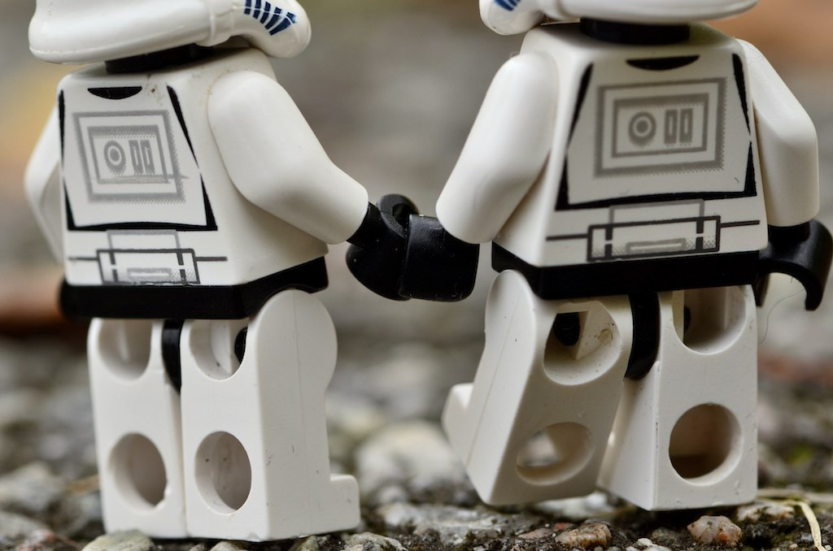
Notes:
Downloaded from flickr under creative commons – photo by Kristen Alexanderson
https://www.flickr.com/photos/kalexanderson/6667747963/in/photolist-bacXaM-akXRDq-8w8Crw-dwwpmv-85amTz-5bqJGd-jKtYW5-5NgUbd-bv1FVM-9DZuxF-8Xrp3V-5Jj28d-o9mQd-5bKiaC-5gtz9g-bacWLz-7F3b9w-35owg7-7xz2Yg-2qk79o-5NgxTY-5NgNzG-4r6Eg-4oJSPr-bqEr3-Hk7vP-59Bc6S-75HgM4-53Gczh-4YyiVp-6CToZN-Y1su-5JjNEw-7emQk5-j2mzUN-5GozfR-8SumjW-SsTUQ-chpTUh-7SMTZw-6F2AZJ-6izpvs-6MibyL-dWWfVX-5NbS8D-5Ng7fb-5NcpuR-5NgdVU-3PRiM1-5NcwC2/

Slide 19
Couples and digital technology
Most online adults don’t think technology has much of an impact on their relationship – and quarter of adults who do, say it’s mostly positive.
Young adults much more likely to report that tech is a factor in their relationships – for good and ill.
Technology can be both a source of tension and intimacy for online couples.
Sharing of passwords is relatively common, while sharing email, calendars and social media is less so.

Slide 20
What impact does the Internet have on couples?
10% of internet users who are married or partnered say that the internet has had a “major impact” on their relationship, and 17% say that it has had a “minor impact.”
72% of married or committed online adults said the internet has “no real impact at all” on their partnership.
74% of the adult internet users who report that the internet had an impact on their marriage or partnership say the impact was positive.
20% said the impact was mostly negative
4% said it was both good and bad.

Slide 21
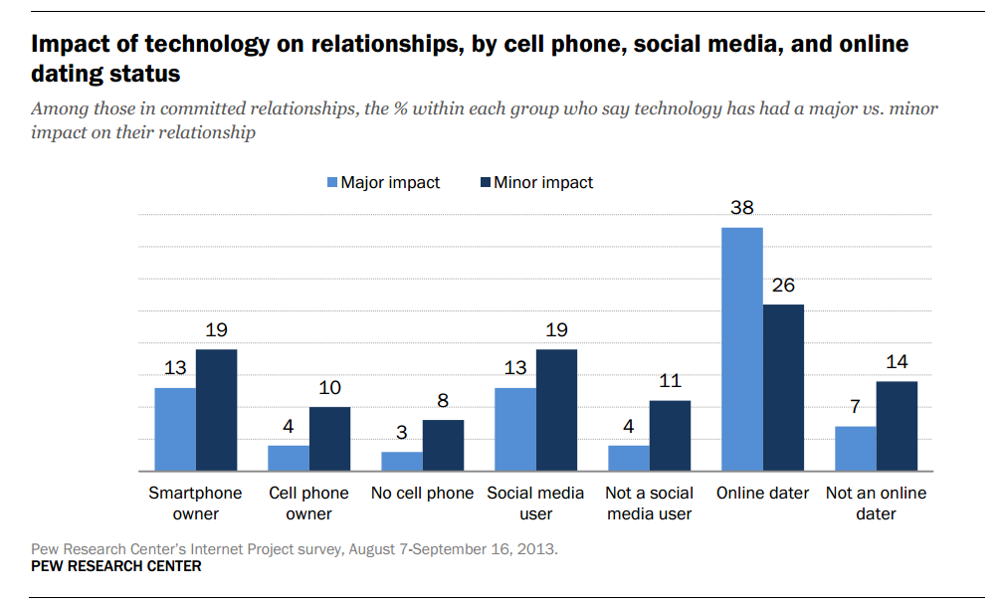

Slide 22
Couples and digital technology
Most online adults don’t think technology has much of an impact on their relationship – and quarter of adults who do, say it’s mostly positive.
Young adults much more likely to report that tech is a factor in their relationships – for good and ill.
Technology can be both a source of tension and intimacy for online couples.
Sharing of passwords is relatively common, while sharing email, calendars and social media is less so.

Slide 23
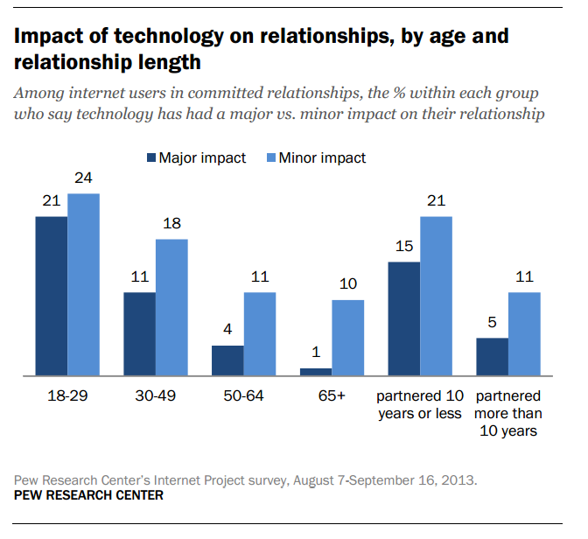

Slide 24
Couples and digital technology
Most online adults don’t think technology has much of an impact on their relationship – and quarter of adults who do, say it’s mostly positive.
Young adults much more likely to report that tech is a factor in their relationships – for good and ill.
Technology can be both a source of tension and intimacy for online couples.
Sharing of passwords is relatively common, while sharing email, calendars and social media is less so.

Slide 25
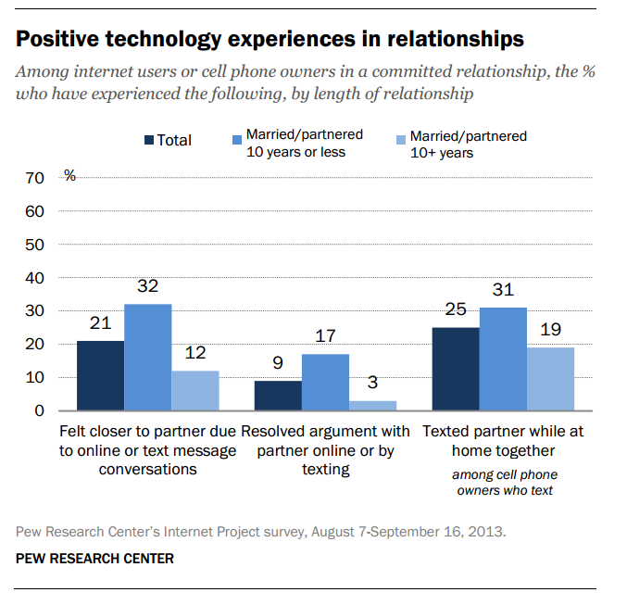

Slide 26
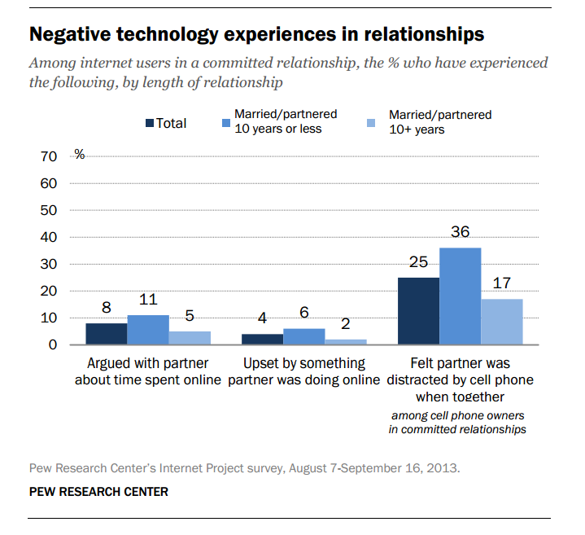

Slide 27
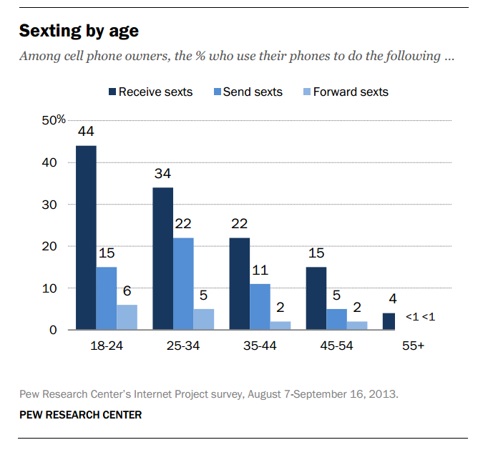

Slide 29
Couples and digital technology
Most online adults don’t think technology has much of an impact on their relationship – and quarter of adults who do, say it’s mostly positive.
Young adults much more likely to report that tech is a factor in their relationships – for good and ill.
Technology can be both a source of tension and intimacy for online couples.
Sharing of passwords is relatively common, while sharing email, calendars and social media is less so.

Slide 30
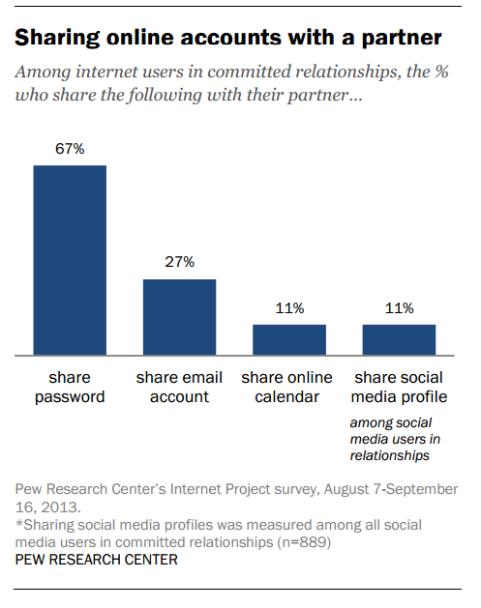

Slide 31
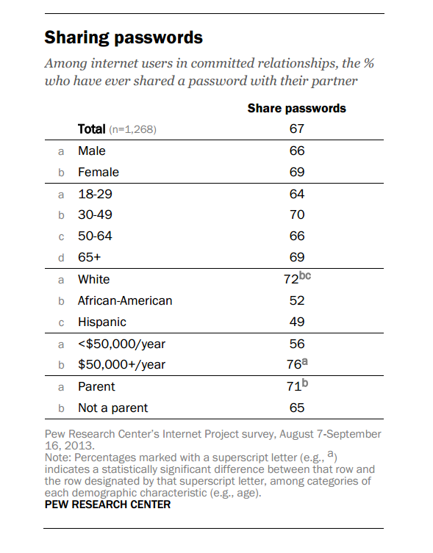

Slide 32
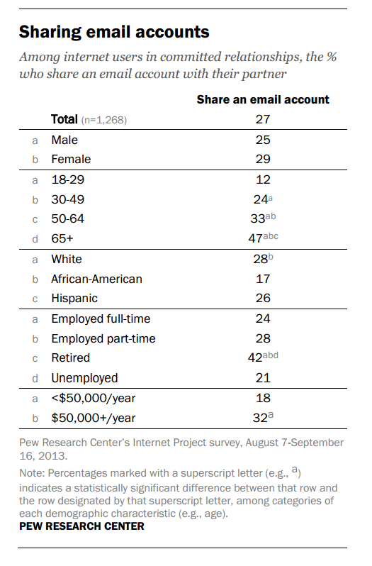

Slide 33
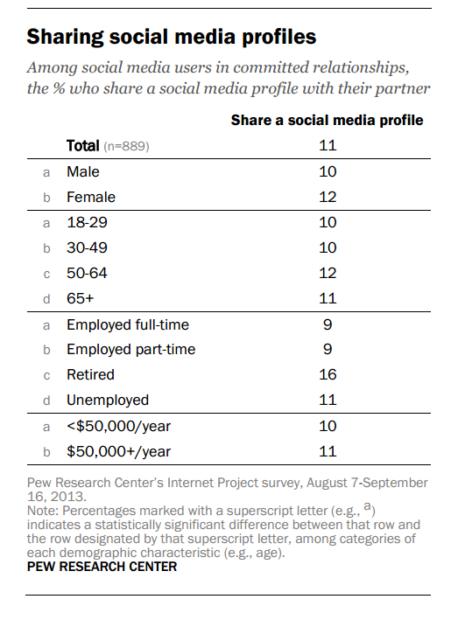

Slide 34
Who Shares an Online Calendar?
Middle aged couples – 16% of 25-34 year olds, and 12% of those ages 35-44, share an online calendar with their partner. Calendar sharing also increases at retirement age, as 11% of those 65 and older share an online calendar with a partner.
Couples with children living at home – 13% of parents share an online calendar.
Those who are employed full-time – 12% of those who are employed full-time share an online calendar with their spouse or partner.
Those with higher income and/or education levels – 16% of college graduates, and 15% of those with an annual household income of $75,000 or more per year, share an online calendar with their spouse or partner.

Slide 35
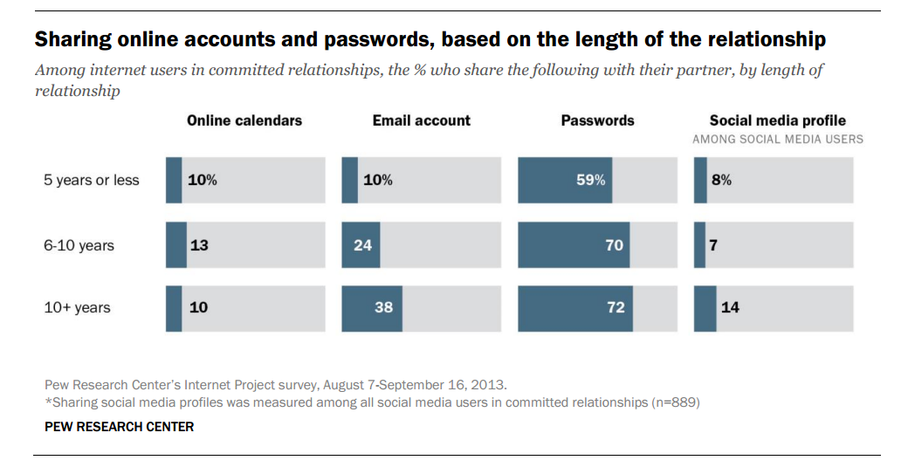

Slide 36
Dating, couples and digital technology
Websites and apps are a part of a modern daters toolkit, especially those from “thin” dating markets.
Stigma is declining as online dating becomes mainstream.
Online dating is generally pretty enjoyable for most people, though women are more likely to have negative experiences.
New kinds of information about potential (and past) partners is plentiful – and tempting.

Slide 37
Dating, couples and digital technology
Tech impact is modest on most couples – but greater on young adults and those in shorter relatioships.
Technology can be both a source of tension and intimacy for online couples.
Digital media is now embedded in the functions and functioning of shared lives.

Slide 38
Amanda Lenhart
Senior Researcher
Pew Research Center’s Internet & American Life Project
alenhart@pewresearch.org
@amanda_lenhart
@pewinternet
@pewresearch

