Slide 1
Networked The New Social Operating System in Civic Life
May 8, 2014
Lee Rainie - @lrainie and lrainie@pewinternet.org
Director, Internet Project

Slide 3
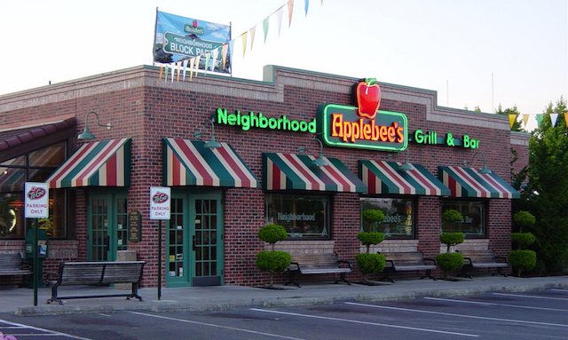
January 25, 2013

Slide 4
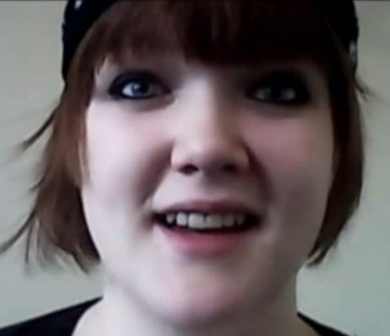
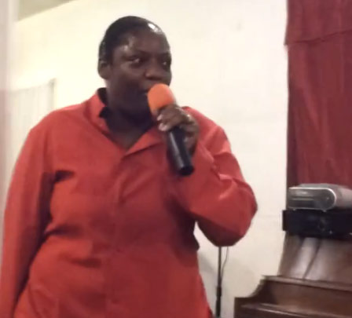
Chelsea Welch
Alois Bell
Notes:
http://news.yahoo.com/applebee-responds-fired-waitress-chelsea-welch-viral-god-184500260.html

Slide 5
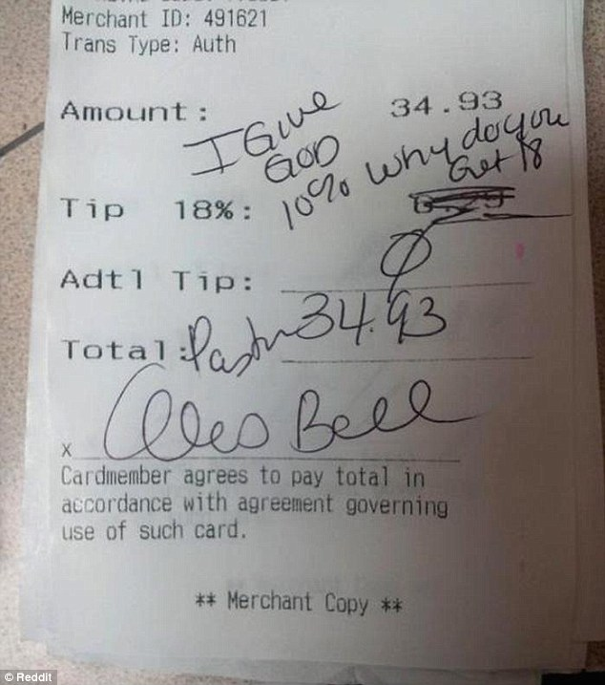

Slide 6
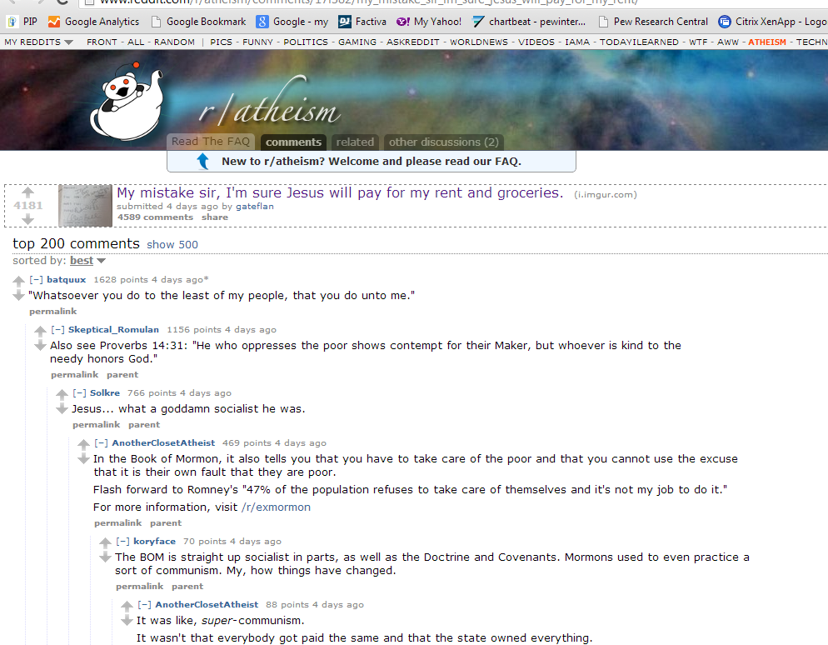
r/atheism
“My mistake sir, I’m sure Jesus will pay for my rent and groceries”

Slide 8
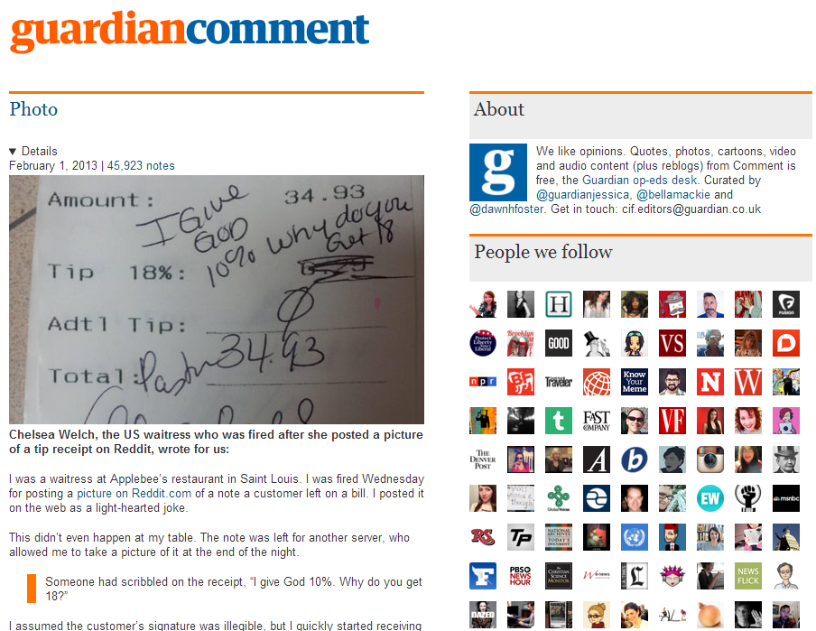
Notes:
http://guardiancomment.tumblr.com/post/42024491123/chelsea-welch-the-us-waitress-who-was-fired-after

Slide 9
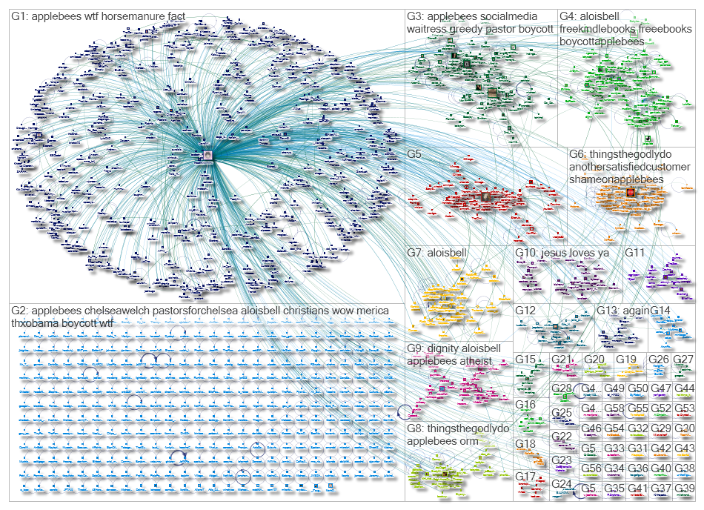
http://nodexlgraphgallery.org/Pages/Graph.aspx?graphID=2701

Slide 10
Top URLs in Tweet in Entire Graph: http://guardiancomment.tumblr.com/post/42024491123/chelsea-welch-the-us-waitress-who-was-fired-after http://www.guardian.co.uk/p/3dfqt/tw http://www.guardian.co.uk/commentisfree/2013/feb/01/fired-applebees-waitress-needs-tips http://www.tumblr.com/ZyqxEwd8sjXp http://www.guardian.co.uk/p/3dfqt http://www.dailydot.com/news/applebees-pastor-tip-waitress-facebook/ http://neil-gaiman.tumblr.com/post/42074466808/guardiancomment-chelsea-welch-the-us-waitress http://m.guardian.co.uk/commentisfree/2013/feb/01/fired-applebees-waitress-needs-tips http://www.wptv.com/dpp/news/local_news/water_cooler/chelsea-welch-applebees-waitress-fired-alois-bell-pastor-complains-about-reddit-receipt-photo http://www.change.org/petitions/applebee-s-and-truth-in-the-word-deliverance-ministries-give-chelsea-welch-her-job-back-and-fire-pastor-alois-bell
http://nodexlgraphgallery.org/Pages/Graph.aspx?graphID=2701

Slide 11
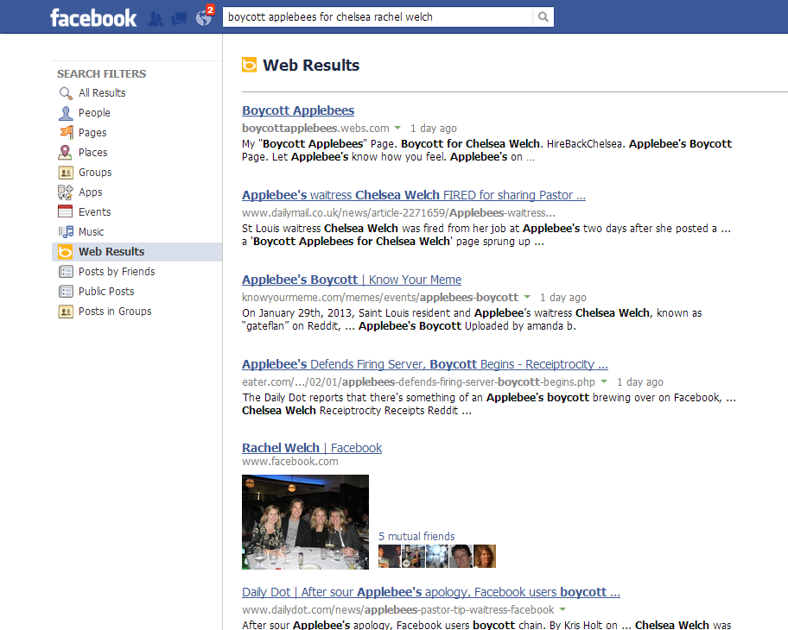

Slide 12
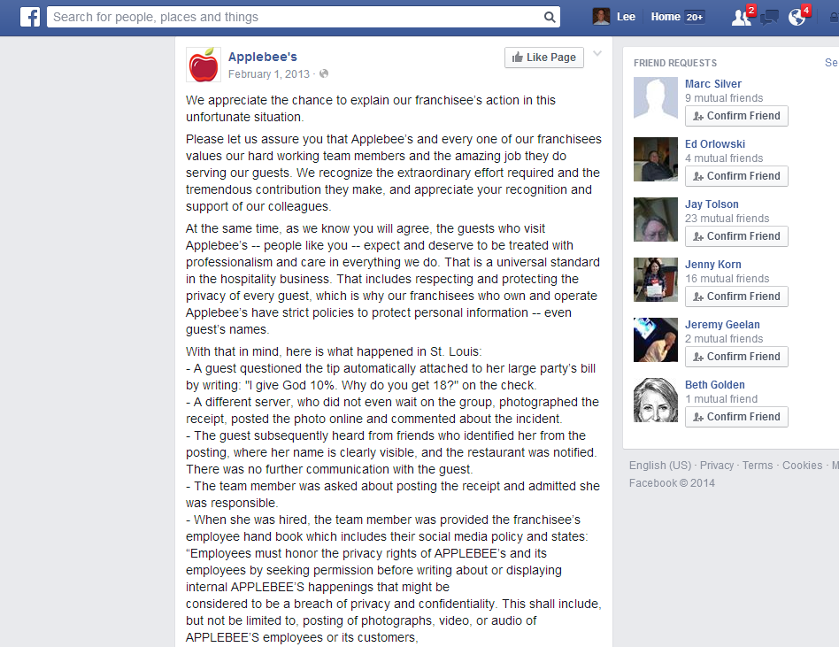

Slide 13
News in the networked age
Impact on civic debate
Impact on news ecosystem
Spiritual precepts and atheism
Vigilantism
Privacy rights, publicity rights, and collapsed contexts
Minimum wage policies & employment practices
Corporate social media policies
New news venues
New news initiators
New gatekeepers, influencers, content drivers well beyond the locale of the news
New pathways to consumers
New role for “people formerly known as the audience” (Jeff Rosen)
New ways to keep the story moving

Slide 14
Civic life is networked life with network information created and shared by networked organizations

Slide 15
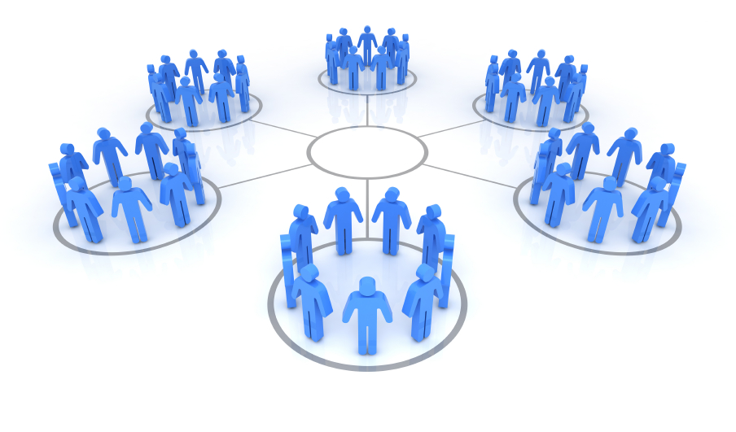
New social and civic reality:
Networked Individualism
The move from tight groups to loose networks

Slide 16
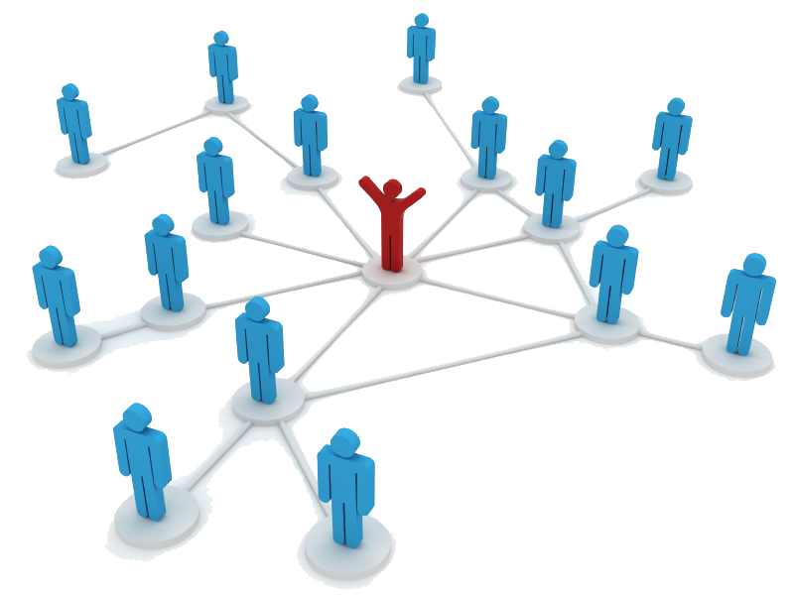
Personal networks are…
Increasingly important – awareness, trust Differently composed – segmented, layered
More personal liberation & more work

Slide 17
But it is not just technological story
Other drivers are changes in … Transportation & living patterns
Identity structures (including in politics, religion)
Family life
Business structures & labor shifts

Slide 18
Technology pushes the Move to networked individualism into overdrive

Slide 19
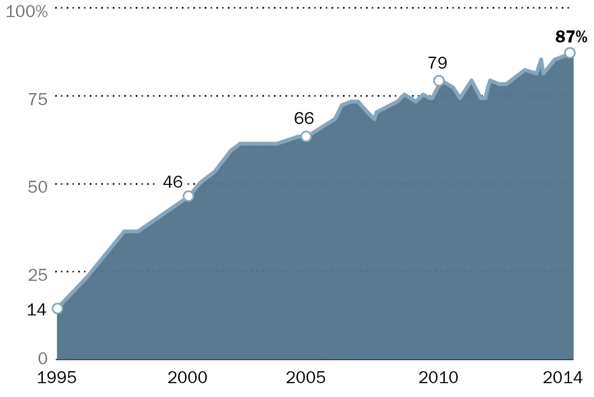
First: Internet – 1995-2014

Slide 20
First: Broadband – 2000-2013

Slide 21
Second: Mobile connectivity – Cell phones

Slide 22
Second: Mobile connectivity - Smartphones

Slide 23
Second: Mobile connectivity – Tablets
Have either one
Tablet owners
E-reader owners

Slide 24
Third: Social networking/media - 61% of all adults
% of internet users

Slide 25
The Landscape of Social Media Users (among adults)
 | % of internet users who…. | The service is especially appealing to
Use Any Social Networking Site | 72% | Adults ages 18-29, women
Use Facebook | 71% | Women, adults ages 18-29
Use Google+ | 31% | Higher educated
LinkedIn | 22% | Adults ages 30-64, higher income, higher educated
Use Pinterest | 21% | Women, adults under 50, whites, those with some college education
Use Twitter | 18% | Adults ages 18-29, African-Americans, urban residents
Use Instagram | 17% | Adults ages 18-29, African-Americans, Latinos, women, urban residents
Use Tumblr | 6% | Adults ages 18-29
reddit | 6% | Men ages 18-29

Slide 26
The social media platforms arts orgs use
Source: Pew Research Center’s Internet & American Life Project Arts Organizations Survey. Conducted between May 30-July 20, 2012. N for respondents who answered this question=1,202.

Slide 27
Number of platforms
The majority of arts organizations that use social media maintain profiles on at least four different social media sites.

Slide 28
Big Change 1: It has networked people and affected key behaviors

Slide 29
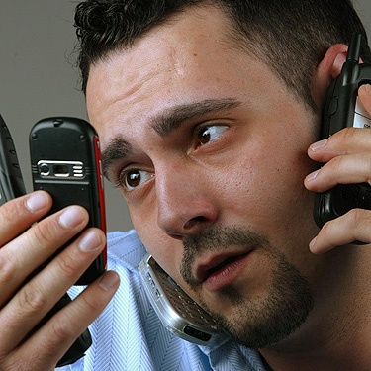
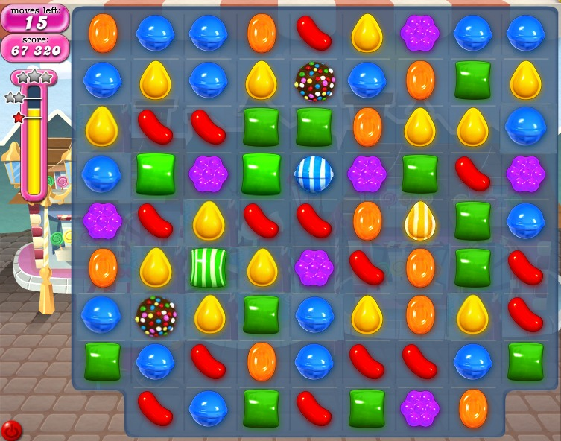
Attention allocation
Streams: Continuous partial attention to screens
Stacks: Immersion in deep dives
Snacks: Info-dosing in free moments

Slide 30
Identity shifts
‘Birth realities’ are joined by ‘my tribes’

Slide 31
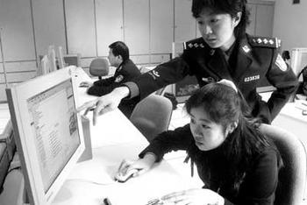
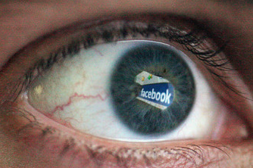
Environment awareness & scrutiny Transparency grows as “trust” benchmark
Surveillance – powerful watch the ordinary
Sousveillance – ordinary watch powerful
Coveillance – peers check up on peers

Slide 32
Big change 2: It has networked information
Pervasively generated
Pervasively consumed
Personal via new filters
Participatory / social
Linked
Continually edited
Multi-platformed
Real-time / just-in-time
Timeless / searchable
Given meaning via networks / algorithms
“Third skin”

Slide 33
Big Change 3: It has changed the civic ecosystem
More niches
More topics of discussion (and different news agendas” thanks to “fifth estate”)
More alliances - para-government activities (“peer progressivism”)
More DIY capabilities
More arguments
More disclosure of all kinds
More people in decision-making spaces -- “wisdom of crowds” and the filtering capacity of algorithms exert influence
More evidence of everything humans do:
Love, Hate
Altruism, Stupidity
Dis- + En-gagement
Notes:
More fracturing of people’s time use and attention

Slide 34
What really isn’t so … in networked life

Slide 35
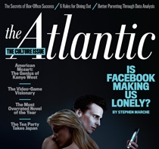
What really isn’t so – 1
Facebook makes you lonely

Slide 36
What really isn’t so – 2
People live in echo chambers in their social networks and information practices

Slide 37
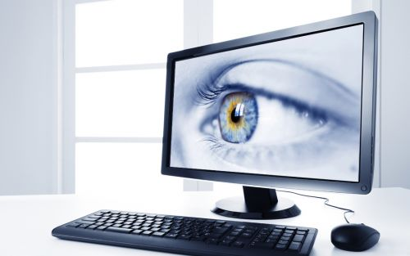
What really isn’t so – 3
People’s views about privacy are binary and immutable

Slide 38
Next revolutions
More tech power - bandwidth, computing power, apps
Better Web + better apps -- expanded search into video and audio plus the “semantic web” plus analytics
New interfaces – haptic, voice, collaborative, brain
Internet of Things: Smart appliances and systems (tech becomes less visible)
3D and 4D printing

Slide 39
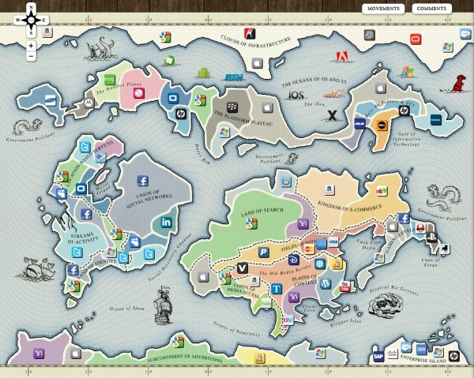
Your map is wrong!

Slide 40
Thank you!

