Slide 1
LIBRARIES & THE BIG PICTURE: FACTS, TRENDS, & NEXT! New data from the Pew Research Center on public library engagement
Kathryn Zickuhr
Research Associate, Pew Research Center’s Internet Project
Computers in Libraries, April 7, 2014
@kzickuhr | @pewinternet | @pewresearch
libraries.pewinternet.org

Slide 2
INTRODUCTION About this research
NEW FINDINGS A closer look at our library engagement typology
COMING SOON Library engagement quiz
libraries.pewinternet.org / @kzickuhr / @pewinternet

Slide 3
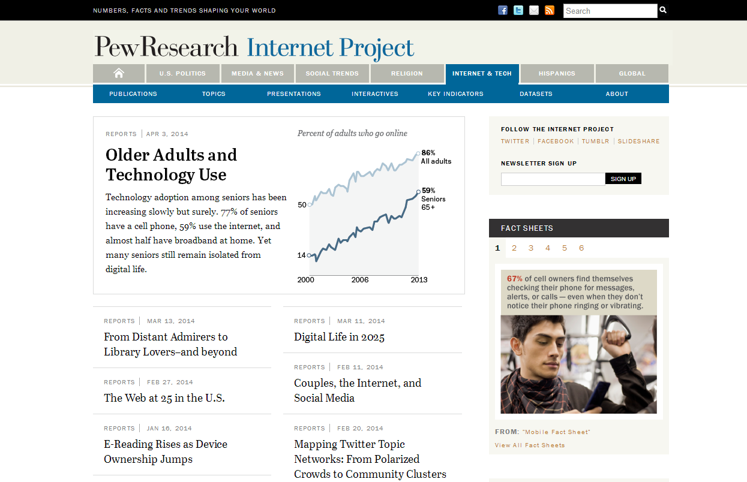
About us
pewresearch.org @pewresearch
pewinternet.org @pewinternet
libraries.pewinternet.org / @kzickuhr / @pewinternet

Slide 4
About our libraries research
Three phases:
State of reading
Library services
Typology
libraries.pewinternet.org
Notes:
For an overview of our research so far, including links to our major reports, see: http://libraries.pewinternet.org/about/research-timeline/

Slide 5
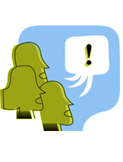
About our libraries research
Nationally representative telephone surveys
Landlines and cell phones
English and Spanish
Americans ages 16 and older
libraries.pewinternet.org
libraries.pewinternet.org / @kzickuhr / @pewinternet
Notes:
For more information, see the Methods section of each report.

Slide 6
INTRODUCTION About this research
NEW FINDINGS A closer look at our library engagement typology
libraries.pewinternet.org / @kzickuhr / @pewinternet
Notes:
Typology: http://www.pewinternet.org/2014/03/13/library-engagement-typology/
For a more straightforward reading of the questions used to build the typology, see: http://libraries.pewinternet.org/2013/12/11/libraries-in-communities/

Slide 7
About the typology
Based on:
Public library use
Experiences at libraries
Views/perceptions of libraries
Broader context:
Info & tech habits
Other community activities
libraries.pewinternet.org / @kzickuhr / @pewinternet
Notes:
More information is available at http://www.pewinternet.org/2014/03/13/about-this-report-and-survey/#about-this-typology and in the Methods section of the report.

Slide 8
Level of engagement | Group name | % of U.S. population ages 16+
High | Library Lovers | 10%
 | Information Omnivores | 20%
Medium | Solid Center | 30%
 | Print Traditionalists | 9%
Low | Not For Me | 4%
 | Young & Restless | 7%
 | Rooted & Roadblocked | 7%
None | Distant Admirers | 10%
 | Off the Grid | 4%
None (14%)
High (30%)
Low (17%)
Medium (39%)
libraries.pewinternet.org / @kzickuhr / @pewinternet
Notes:
The main report is available at: http://www.pewinternet.org/2014/03/13/library-engagement-typology/

Slide 9
High Engagement (30%)
libraries.pewinternet.org / @kzickuhr / @pewinternet

Slide 10
Group name | Engagement level | % of U.S. population | Major characteristics
Library Lovers | High | 10% | Frequent library use, high levels of appreciation/familiarity Includes many parents, students, and job seekers Tend to be younger, with higher levels of education
libraries.pewinternet.org / @kzickuhr / @pewinternet

Slide 11
Group name | Engagement level | % of U.S. population | Major characteristics
Information Omnivores | High | 20% | High levels of library use, but visits are less frequent than Library Lovers’ Highest rates of technology use Highest levels of education, employment, household income.
libraries.pewinternet.org / @kzickuhr / @pewinternet

Slide 12
Medium Engagement (39%)
libraries.pewinternet.org / @kzickuhr / @pewinternet

Slide 13
Group name | Engagement level | % of U.S. population | Major characteristics
Solid Center | Medium | 30% | About half have used a public library in the past year Most view libraries positively. Similar to general U.S. population
libraries.pewinternet.org / @kzickuhr / @pewinternet

Slide 14
Group name | Engagement level | % of U.S. population | Major characteristics
Print Traditionalists | Medium | 9% | Similar to Solid Center, except tend to live farther away from libraries (61% live in rural areas) Highest proportion of rural, Southern, or white respondents
libraries.pewinternet.org / @kzickuhr / @pewinternet

Slide 15
Low Engagement (17%)
libraries.pewinternet.org / @kzickuhr / @pewinternet

Slide 16
Group name | Engagement level | % of U.S. population | Major characteristics
Not for Me | Low | 4% | Strikingly less positive views of public libraries’ roles in the community More likely to have had negative experiences at libraries
libraries.pewinternet.org / @kzickuhr / @pewinternet

Slide 17
% who strongly agree that public libraries…
libraries.pewinternet.org / @kzickuhr / @pewinternet

Slide 18
Group name | Engagement level | % of U.S. population | Major characteristics
Young & Restless | Low | 7% | Relatively young group: Median age is 33. Few have lived in their neighborhoods for very long. Only 15% know where the nearest public library is located.
libraries.pewinternet.org / @kzickuhr / @pewinternet

Slide 19
% who know where the nearest public library is located
libraries.pewinternet.org / @kzickuhr / @pewinternet

Slide 20
Group name | Engagement level | % of U.S. population | Major characteristics
Rooted & Roadblocked | Low | 7% | Generally views public libraries positively, but many face hurdles in their lives Tend to be older; many are living with disability or have experienced a recent illness in their family.
libraries.pewinternet.org / @kzickuhr / @pewinternet

Slide 21
% who say their library’s closing would have a major impact on…
libraries.pewinternet.org / @kzickuhr / @pewinternet

Slide 22
No Engagement (14%)
libraries.pewinternet.org / @kzickuhr / @pewinternet

Slide 23
Group name | Engagement level | % of U.S. population | Major characteristics
Distant Admirers | None | 10% | No personal library use Many (40%) say other family members use libraries Most view libraries quite positively; many also say that library services are important to them and their families Tend to be older; often live in lower-income households.
libraries.pewinternet.org / @kzickuhr / @pewinternet

Slide 24
Group name | Engagement level | % of U.S. population | Major characteristics
Off the Grid | None | 4% | No personal library use Little exposure to libraries overall May be less engaged with community activities and social life. Many live in rural areas; just 56% use the internet. Low household incomes & low levels of education (only one in ten has graduated from college)
libraries.pewinternet.org / @kzickuhr / @pewinternet

Slide 25
Public library engagement typology: Group overviews
Level of engagement with public libraries | Group name | % of U.S. population ages 16+ | Major characteristics
High engagement ~80% used a public library in the past year | Library Lovers | 10% | Frequent library use, high appreciation Includes many parents, students, and job seekers Tend to be younger, with higher levels of education
 | Information Omnivores | 20% | High levels of library use, but visits are less frequent than Library Lovers’. Highest rates of technology use Highest levels of education, employment, and household income.
Medium engagement ~50% used a public library in the past year | Solid Center | 30% | About half have used a public library in the past year Most view libraries positively. Similar to the general U.S. population in most demographic measures.
 | Print Traditionalists | 9% | Similar to Solid Center, except tend to live farther away from libraries Most view libraries as important to community Highest proportion of rural, Southern, or white respondents
Low engagement ~30% used a public library in the past year | Not For Me | 4% | Strikingly negative views of public libraries Ex: Are far less likely than most other groups to say public libraries are important to their communities
 | Young & Restless | 7% | Relatively young group; few of its members have lived in their neighborhoods for very long. Only 15% know where the nearest public library is located.
 | Rooted & Roadblocked | 7% | Generally views public libraries positively, but many face hurdles in their lives Tend to be older; many are living with disability or have experienced a recent illness in their family.
None Have never personally used a public library | Distant Admirers | 10% | 40% say other family members use libraries Most view libraries quite positively; many also say that library services are important to them and their families Tend to be older; often live in lower-income households.
 | Off the Grid | 4% | Little exposure to libraries overall May be less engaged with community activities and social life. Many live in rural areas; just 56% use the internet. Low household incomes & low levels of education (only one in ten has graduated from college)
libraries.pewinternet.org / @kzickuhr / @pewinternet

Slide 26
Library engagement typology
Relationships to libraries are part of Americans’ broader resource networks
libraries.pewinternet.org / @kzickuhr / @pewinternet
Notes:
See also: http://libraries.pewinternet.org/2014/03/18/a-new-way-of-looking-at-public-library-engagement-in-america/

Slide 27
Library engagement typology
Relationships to libraries are part of Americans’ broader resource networks
Library use vs importance
libraries.pewinternet.org / @kzickuhr / @pewinternet
Notes:
See also: http://libraries.pewinternet.org/2014/03/18/a-new-way-of-looking-at-public-library-engagement-in-america/

Slide 28
Library engagement typology
Relationships to libraries are part of Americans’ broader resource networks
Library use vs importance
Groups may surprise you
libraries.pewinternet.org / @kzickuhr / @pewinternet
Notes:
See also: http://libraries.pewinternet.org/2014/03/18/a-new-way-of-looking-at-public-library-engagement-in-america/

Slide 29
INTRODUCTION About this research
NEW FINDINGS A closer look at our library engagement typology
COMING SOON Library engagement quiz What kind of library user are you?
libraries.pewinternet.org / @kzickuhr / @pewinternet
Notes:
Coming this summer

Slide 30
pewinternert.org
Newsletter > Online activities > Libraries
libraries.pewinternet.org / @kzickuhr / @pewinternet
Notes:
http://www.pewinternet.org/

Slide 31
What do Americans want from libraries?
More activities, more separate spaces
…and print books, quiet
Convenience & tech (apps, e-books, kiosks)
… and closer relationships with librarians
libraries.pewinternet.org / @kzickuhr / @pewinternet
Notes:
For more information, see “Library services in the digital age”: http://libraries.pewinternet.org/2013/01/22/library-services/

Slide 32
Thank you!
Kathryn Zickuhr
Pew Research Center
Research Associate
pewresearch.org
kzickuhr@pewresearch.org
Computers in Libraries, April 7, 2014
@kzickuhr | @pewinternet | @pewresearch
libraries.pewinternet.org
Notes:
All library-related reports are available at: http://libraries.pewinternet.org/category/publications/survey-reports/

