Slide 1
Teens and Libraries in Today’s Digital World
Lee Rainie
Director – Pew Internet Project
April 9, 2014
Texas Library Association
@lrainie | @pewinternet | @pewresearch

Slide 2
“Tell the truth, and trust the people”
-- Joseph N. Pew, Jr.
http://bit.ly/dUvWe3
http://bit.ly/100qMub
pewinternet.org
libraries.pewinternet.org

Slide 3
7 takeaways from our research
Teens live in a different information ecosystem
Teens live in a different learning ecosystem
Teens’ reading efforts match/exceed adult levels
Teens use libraries and librarians more than others, but don’t necessarily love libraries as much
Teens have different priorities in library services
Teens will behave differently in the world to come
The public and teachers recognize this and want libraries to adjust to it

Slide 4
7 takeaways from our research
Teens live in a different information ecosystem
Teens live in a different learning ecosystem
Teens’ reading efforts match/exceed adult levels
Teens use libraries and librarians more than others, but don’t necessarily love libraries as much
Teens have different priorities in library services
Teens will behave differently in the world to come
The public and teachers recognize this and want libraries to adjust to it

Slide 5
The super-tech-saturated teens
95% use internet / ~ three-quarters have broadband at home
74% access internet on mobile device – 25% “cell mostly” internet users
78% have cell phones / 47% have smartphones
80% have desktop/laptop
23% have tablet computers
81% use social networking sites
76% use Facebook - 24% use Twitter
Approx. from young adult data: a quarter of teens use Instagram; 1 in 7 use Pinterest; 1 in 10 use Tumblr

Slide 6
Data and info is a
‘third skin’

Slide 7
7 takeaways from our research
Teens live in a different information ecosystem
Teens live in a different learning ecosystem
Teens’ reading efforts match/exceed adult levels
Teens use libraries and librarians more than others, but don’t necessarily love libraries as much
Teens have different priorities in library services
Teens will behave differently in the world to come
The public and teachers recognize this and want libraries to adjust to it

Slide 8
Online survey of 2,462 teachers with College Board / National Writing Project
77% of teachers surveyed say the internet and digital search tools have had a “mostly positive” impact on their students’ research work”
87% agree these technologies are creating an “easily distracted generation with short attention spans”
Notes:
Among the more positive impacts they see: the best students access a greater depth and breadth of information on topics that interest them; students can take advantage of the availability of educational material in engaging multimedia formats; and many become more self-reliant researchers.
At the same time, these teachers juxtapose these benefits against some emerging concerns. Specifically, some teachers worry about students’ overdependence on search engines; the difficulty many students have judging the quality of online information; the general level of literacy of today’s students; increasing distractions pulling at students and poor time management skills; students’ potentially diminished critical thinking capacity; and the ease with which today’s students can borrow from the work of others.
These teachers report that students rely mainly on search engines to conduct research, in lieu of other resources such as online databases, the news sites of respected news organizations, printed books, or reference librarians.
Overall, the vast majority of these teachers say a top priority in today’s classrooms should be teaching students how to “judge the quality of online information.” As a result, a significant portion of the teachers surveyed here report spending class time discussing with students how search engines work, how to assess the reliability of the information they find online, and how to improve their search skills. They also spend time constructing assignments that point students toward the best online resources and encourage the use of sources other than search engines.

Slide 9
76% of the teachers in this study strongly agree “the internet enables students to access a wider range of resources than would otherwise be available”
76% strongly agree that internet “search engines have conditioned students to expect to be able to find information quickly and easily”

Slide 10
65% agree to some extent that “the internet makes today’s students more self-sufficient researchers”
83% agree that the “amount of information available online today is overwhelming to most students”
Notes:
Large majorities also agree with the notion that the amount of information available online today is overwhelming to most students (83%) and that today’s digital technologies discourage students from using a wide range of sources when conducting research (71%).

Slide 11
90% agree that “the internet encourages learning by connecting students to resources about topics of interest to them”
71% agree that today’s digital technologies “discourage students from using a wide range of sources when conducting research”

Slide 12
Grading students’ research skills

Slide 13
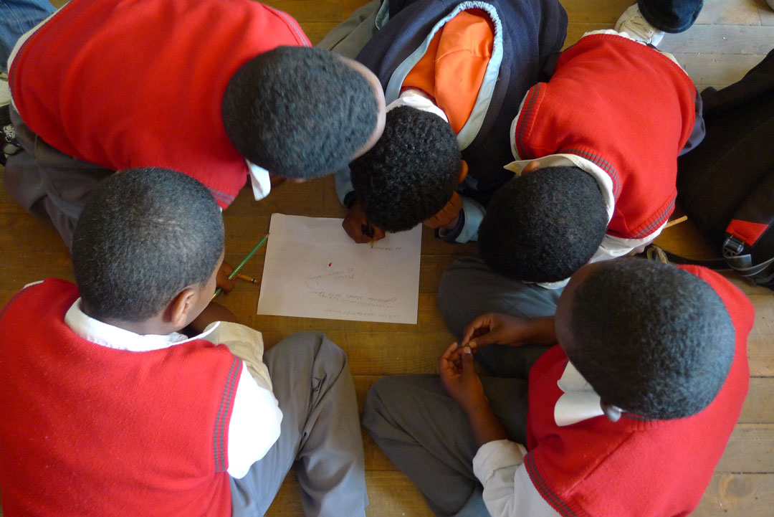
Upshot: Learning is a process; more than it is a transaction

Slide 14
“Today’s students are really no different from previous generations, they just have different tools through which to express themselves.”
Agree
Disagree
47%
52%

Slide 15
7 takeaways from our research
Teens live in a different information ecosystem
Teens live in a different learning ecosystem
Teens’ reading efforts match/exceed adult levels
Teens use libraries and librarians more than others, but don’t necessarily love libraries as much
Teens have different priorities in library services
Teens will behave differently in the world to come
The public and teachers recognize this and want libraries to adjust to it

Slide 16
How many books Americans read Among book readers, the mean and median number of books each group read in the past 12 months, among all Americans ages 16 and older
 | Mean number of books read (average) | Median (midpoint)
All those 16 and older | 17 | 8
Ages 16-7 | 18 | 10
Ages 18-24 | 17 | 7
Ages 25-29 | 17 | 6
Ages 30-39 | 14 | 6
Ages 40-49 | 15 | 6
Ages 50-64 | 18 | 8
Ages 65+ | 23 | 12
Source: Pew Research Center’s Internet & American Life Reading Habits Survey, November 16-December 21, 2011. N=2,986 respondents ages 16 and older. Interviews were conducted in English and Spanish and on landline and cells. N for those who have read book year=2,474.

Slide 17
Reading on a “typical day” (among book readers)

Slide 18
Young readers are instrumental readers

Slide 19
Young e-book readers read on all kinds of devices

Slide 20
7 takeaways from our research
Teens live in a different information ecosystem
Teens live in a different learning ecosystem
Teens’ reading efforts match/exceed adult levels
Teens use libraries and librarians more than others, but don’t necessarily love libraries as much
Teens have different priorities in library services
Teens will behave differently in the world to come
The public and teachers recognize this and want libraries to adjust to it

Slide 21
Used library in past year

Slide 22
Got help from a librarian (among library users)

Slide 23
Closing the library would have a major impact on my community as a whole

Slide 24
7 takeaways from our research
Teens live in a different information ecosystem
Teens live in a different learning ecosystem
Teens’ reading efforts match/exceed adult levels
Teens use libraries and librarians more than others, but don’t necessarily love libraries as much
Teens have different priorities in library services
Teens will behave differently in the world to come
The public and teachers recognize this and want libraries to adjust to it

Slide 25
Teens say they would likely use …

Slide 26
7 takeaways from our research
Teens live in a different information ecosystem
Teens live in a different learning ecosystem
Teens’ reading efforts match/exceed adult levels
Teens use libraries and librarians more than others, but don’t necessarily love libraries as much
Teens have different priorities in library services
Teens will behave differently in the world to come
The public and teachers recognize this and want libraries to adjust to it

Slide 27
How will hyperconnected Millennials live? http://pewinternet.org/Reports/2012/Hyperconnected-lives.aspx

Slide 28
Vote for …

Slide 29
Millennials’ future
In 2020 the brains of multitasking teens and young adults are "wired" differently from those over age 35 and overall it yields helpful results. They do not suffer notable cognitive shortcomings as they multitask and cycle quickly through personal- and work-related tasks. Rather, they are learning more and they are more adept at finding answers to deep questions, in part because they can search effectively and access collective intelligence via the Internet. In sum, the changes in learning behavior and cognition among the young generally produce positive outcomes.

Slide 30
… or …

Slide 31
Millennials’ future
In 2020, the brains of multitasking teens and young adults are "wired" differently from those over age 35 and overall it yields baleful results. They do not retain information; they spend most of their energy sharing short social messages, being entertained, and being distracted away from deep engagement with people and knowledge. They lack deep-thinking capabilities; they lack face-to-face social skills; they depend in unhealthy ways on the Internet and mobile devices to function. In sum, the changes in behavior and cognition among the young are generally negative outcomes.

Slide 32
Millennials’ future
Change for the better
Change for the worse
52%
42%

Slide 33
Theme - Supertaskers

Slide 34
Theme – New winners/losers

Slide 35
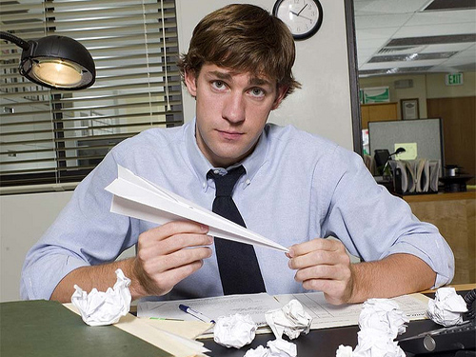
Theme – Distracted

Slide 36
7 takeaways from our research
Teens live in a different information ecosystem
Teens live in a different learning ecosystem
Teens’ reading levels match/exceed adult levels
Teens use libraries and librarians more than others, but don’t necessarily love libraries as much
Teens have different priorities in library services
Teens will behave differently in the world to come
The public and teachers recognize this and want libraries to adjust to it

Slide 37
Teachers press for literacy
57% spend class time helping students improve their search skills
35% devote class time to helping students understand how search engines work and how search results are generated
Asked what curriculum changes might be necessary in middle and high schools today, 47% “strongly agree” and 44% “somewhat agree” that courses or content focusing on digital literacy must be incorporated into every school’s curriculum.

Slide 38
Coordinate more closely with local schools in providing resources to kids
Offer free early literacy programs to help young children prepare for school

Slide 39
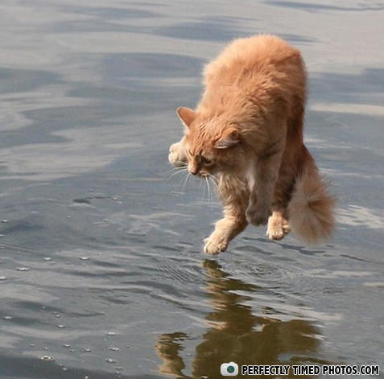
Be not afraid

Slide 40
Libraries.pewinternet.org
Lee Rainie
Email: lrainie@pewinternet.org
Twitter: @Lrainie
Kathryn Zickuhr
Email: kzickuhr@pewinternet.org
Twitter: @kzickuhr
Kristen Purcell
Email: @kpurcell@pewinternet.org
Twitter: @kristenpurcell

